Slide 1
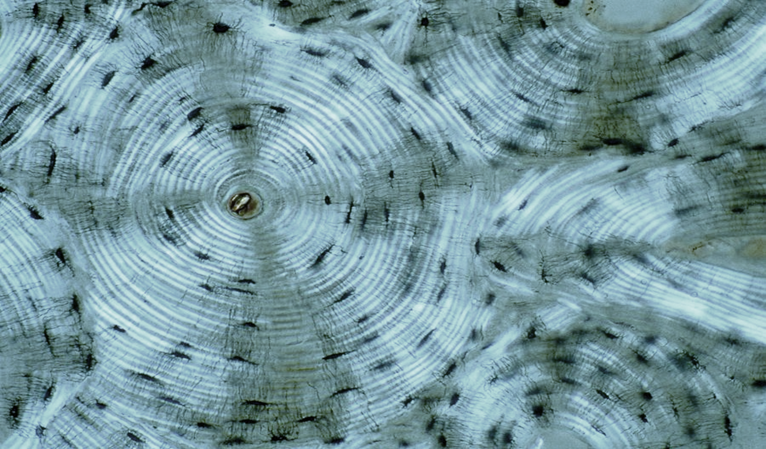
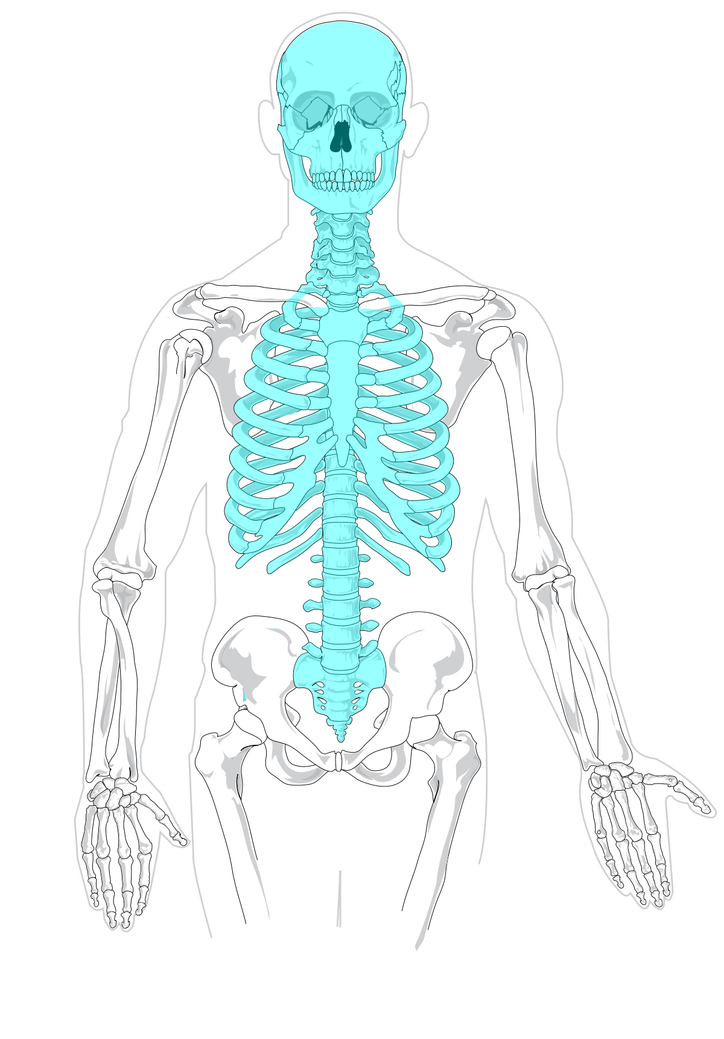
Chapter 7: Axial Skeleton
Dr. Talbott
Laramie County Community College

Slide 2
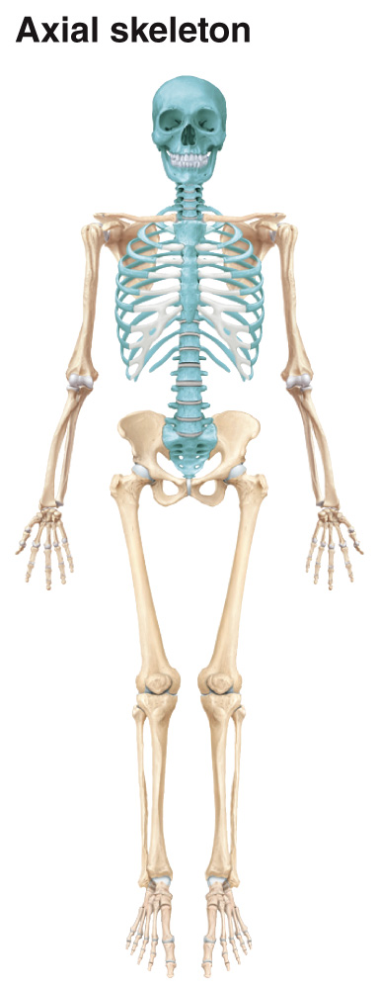
Axial vs. Appendicular Skeleton
axial skeleton: consists of the bones that lie around the longitudinal axis of the body
appendicular skeleton: consists of bones of the upper and lower limbs + the bones forming the girdles: connecting limbs to the axial skeleton

Slide 3
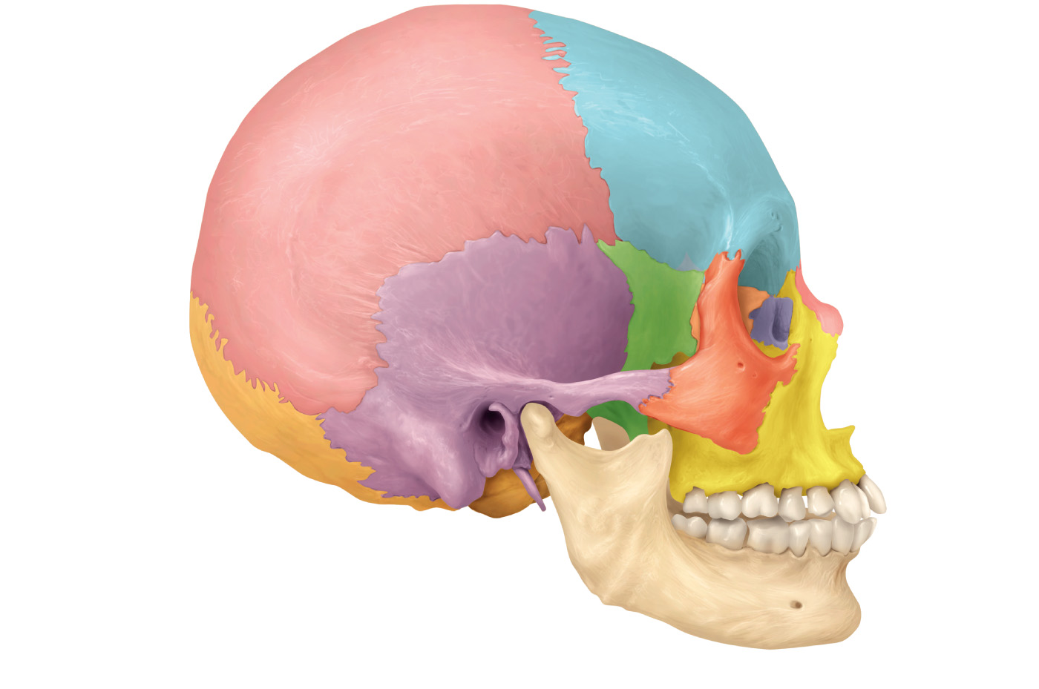
Cranial Bones – External View
skull: bony framework of the head, 22 bones
cranial bones: those that form the cranial cavity (8)
facial bones
parietal bones (2)
frontal bone
sphenoid bone
temporal bones (2)
ethmoid bone
occipital bone
(a) Right lateral view
Old People From Texas Eat Spiders

Slide 4
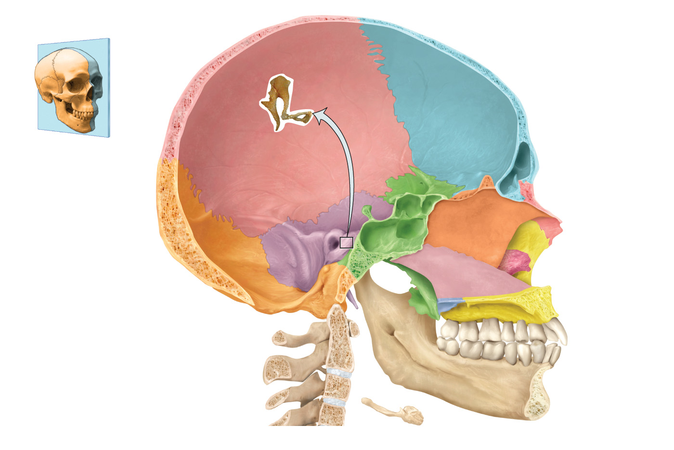
Cranial Bones – Midsagittal View
frontal bone
Sagittal
plane
View
ethmoid bone
parietal bones (2)
temporal bones (2)
sphenoid bone
occipital bone
Medial view of sagittal section

Slide 5
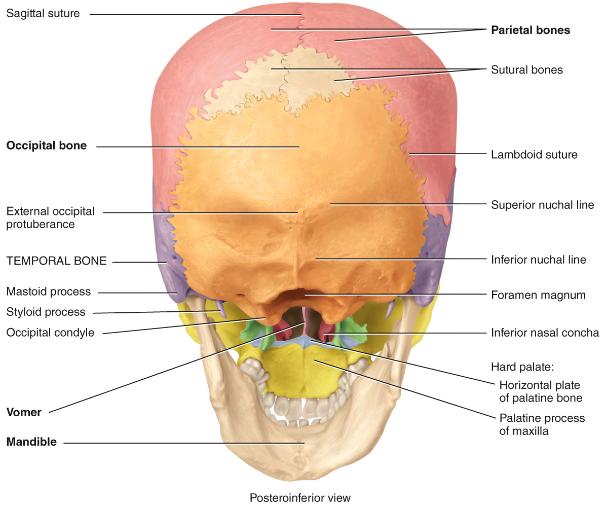
Cranial Bones – Posteroinferior View

Slide 6
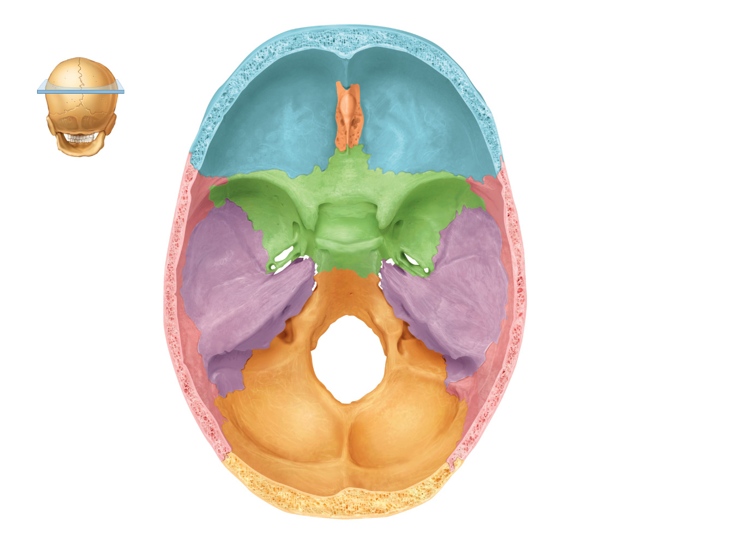
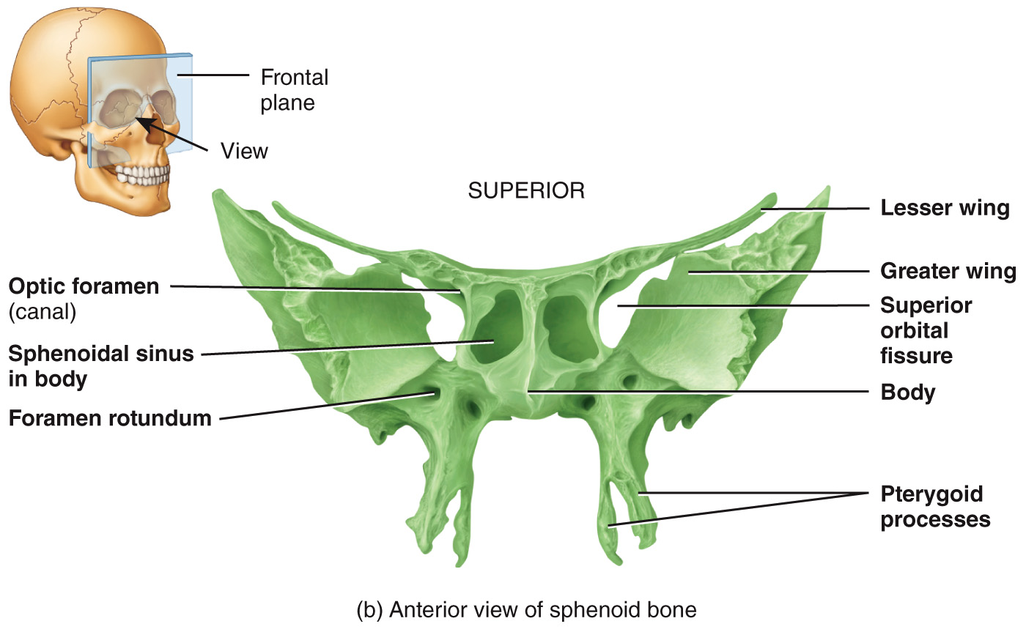
Sphenoid bone
sphenoid bone: lies at the middle part of the base of the skull → “keystone” of the cranial floor b/c it articulates with all the other cranial bones → houses some notable foramen = openings thru which vessels, nerves, ligaments pass
Video: https://www.anatomystandard.com/Cranium/Neurocranium/Sphenoid.html

Slide 7
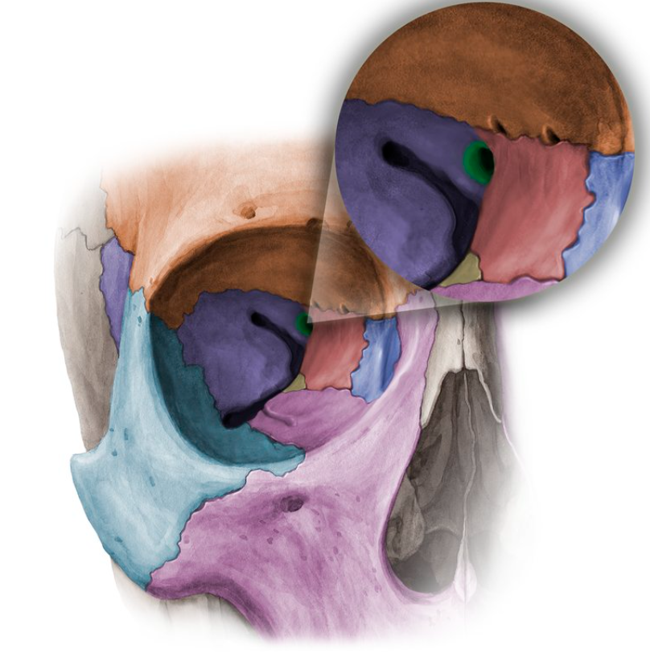
Sphenoid
optic foramen (canal): transmits the optic nerve (CN II) and the ophthalmic artery
superior orbital fissure: transmits the trigeminal (CN V), abducens (CN VI), trochlear (CN IV), and oculomotor nerve (CN III)
inferior orbital fissure: transmits branches of the trigeminal (CN V)
optic foramen
superior orbital fissure
inferior orbital fissure

Slide 8
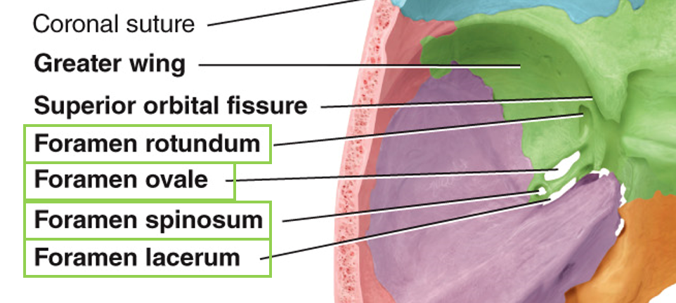
Sphenoid
foramen rotundum: transmits the maxillary (branch of CN V, trigeminal)
foramen ovale: transmits mandibular nerve (branch of CN V, trigeminal)
foramen spinosum: transmits the anterior branch of the middle meningeal artery
foramen lacerum: transmits branch of ascending pharyngeal artery

Slide 9
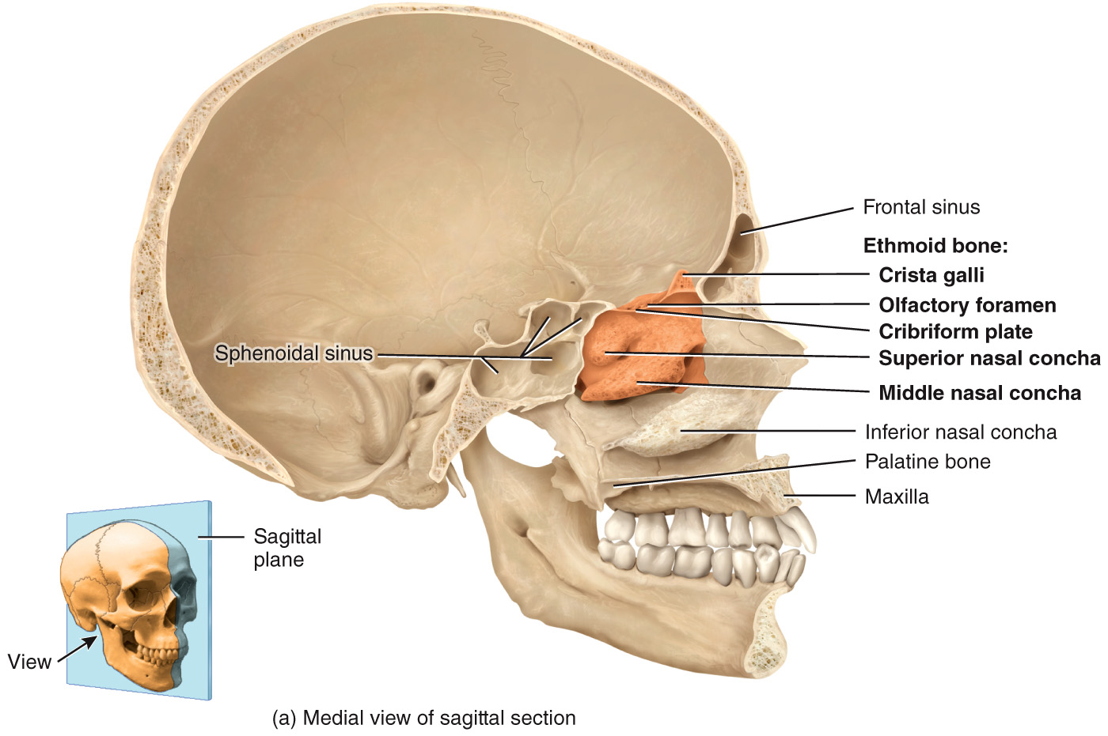
Ethmoid bone
ethmoid bone: forms the…
[1] anterior part of the cranial floor
[2] medial wall of the orbits
[3] superior portion of the nasal septum
[4] most superior supporting structure of the nasal cavity

Slide 10
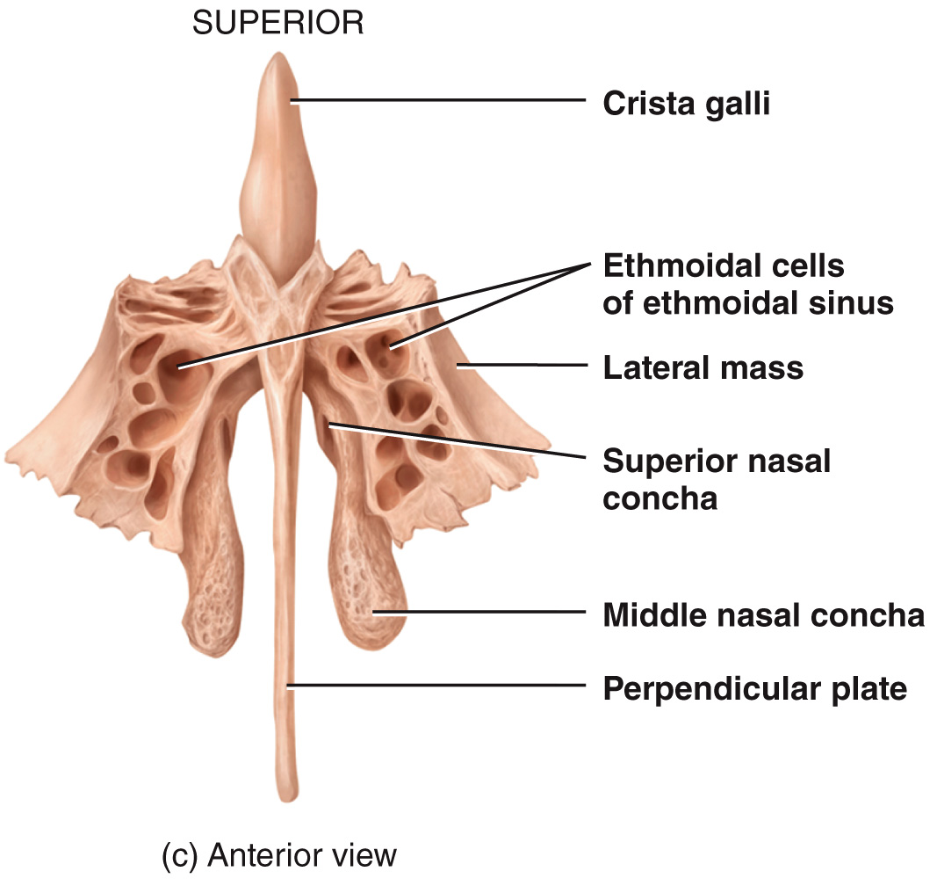
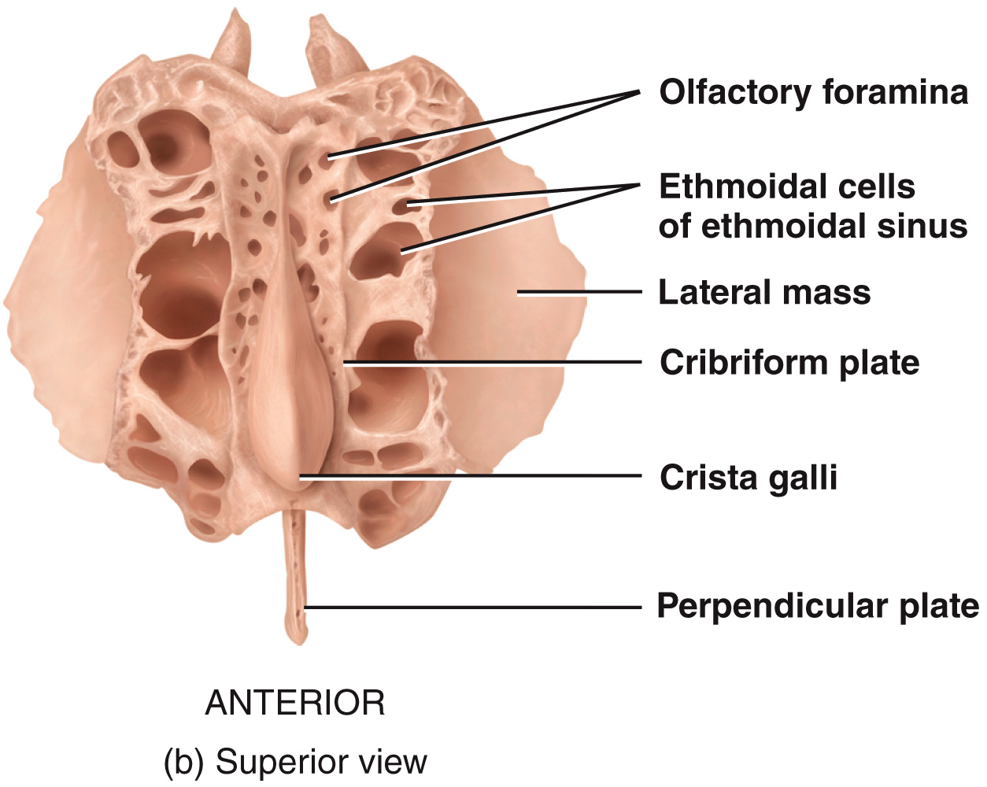
Ethmoid
[1] cribriform plate: lies in the anterior floor of the cranium and forms the roof of the nasal cavity → contains the olfactory foramina through which the olfactory nerves pass
[2] crista galli: projects superiorly from the cribriform plate and serves as a point of attachment for the falx cerebri: membrane that separates brain hemispheres

Slide 11
Ethmoid
[3] perpendicular plate: projects inferiorly from the cribriform plate and forms the superior portion of the nasal septum
[4] lateral masses: contain air spaces called ethmoidal cells that form the ethmoidal sinus
superior nasal concha and middle nasal concha: increase vascular and mucus membrane surface area in nasal cavity which warms and moistens inhaled air before it passes into the lungs

Slide 12
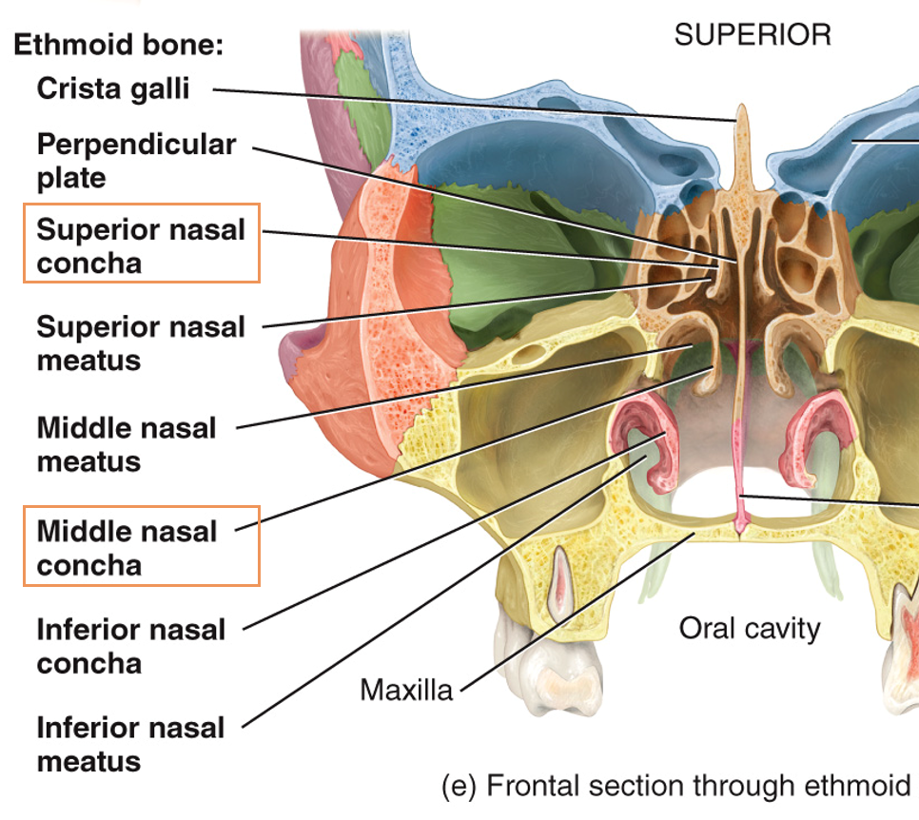
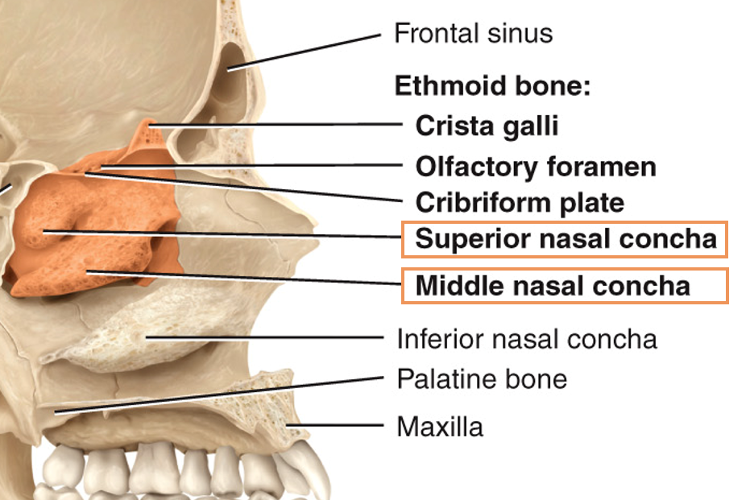
Ethmoid
sagittal view:
frontal view:
Video: https://www.anatomystandard.com/Cranium/Neurocranium/Ethmoid.html

Slide 13
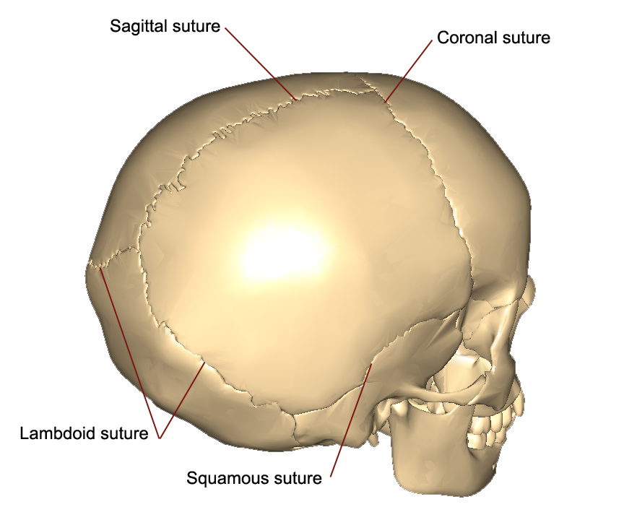
Cranial Bones – Sutures
suture: an immovable joint (in adults) that holds most skull bones together → sutures in the skull of infants and children are often movable and function as growth centers
[1] coronal suture: unites frontal bone with both parietal bones
[2] sagittal suture: unites the 2 parietal bones
[3] lamboid suture: unites the 2 parietal bones with the occipital bone
[4] squamous sutures (2): unites the parietal and temporal bones on the lateral aspects of the skull

Slide 14
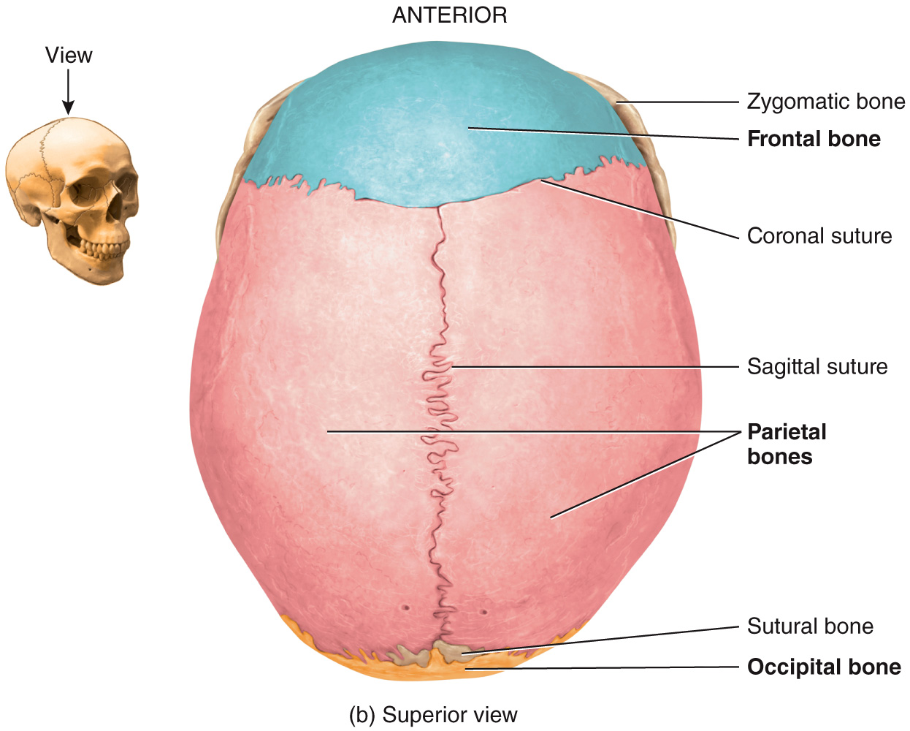
Cranial Bones – Sutures

Slide 15
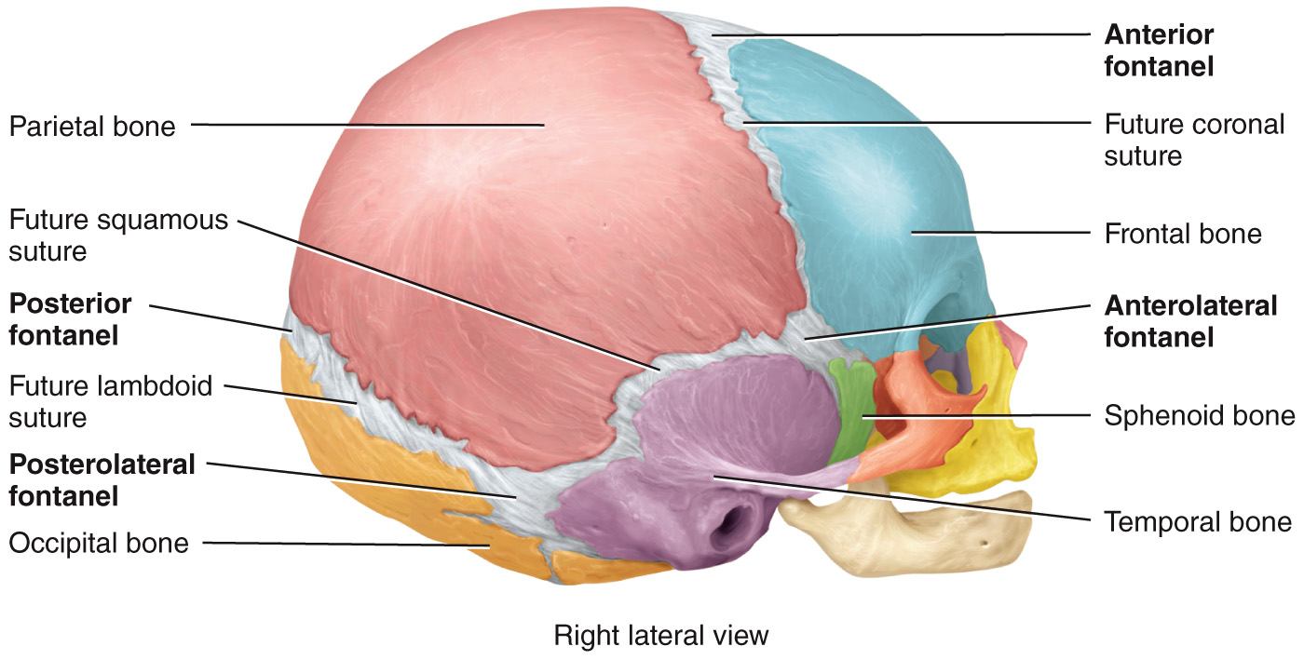
Cranial Bones – Fontanels
fontanel (aka “softspots”): areas where unossified mesenchyme develops into dense connective tissue of the skull → as bone formation continues after birth, the fontanels are eventually replaced with bone and the thin collagenous connective tissue junctions that remain between neighboring bones become the sutures

Slide 16
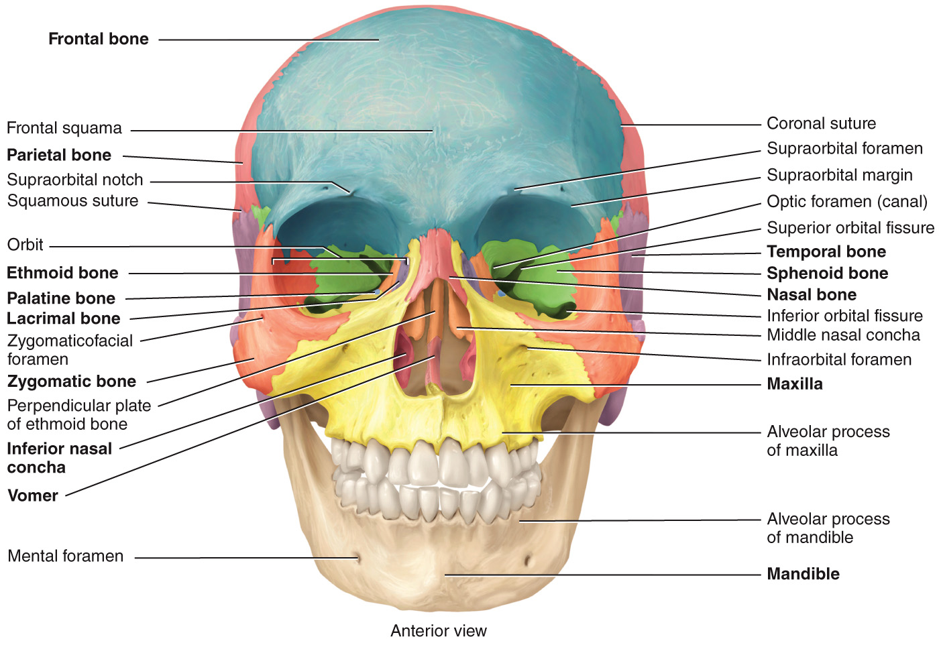
Facial Bones
skull: [2] facial bones: form the face (14)
maxillae bones (2)
mandible
chonchae (2)
nasal (2)
vomer
lacrimal (2)
zygomatic (2)
palatine (2)
My Mandible Chews Nine Very Large Zucchini Pizzas

Slide 17
Facial Bones
My
Mandible
Chews
Nine
Very
Large
Zucchini
Pizzas

Slide 18
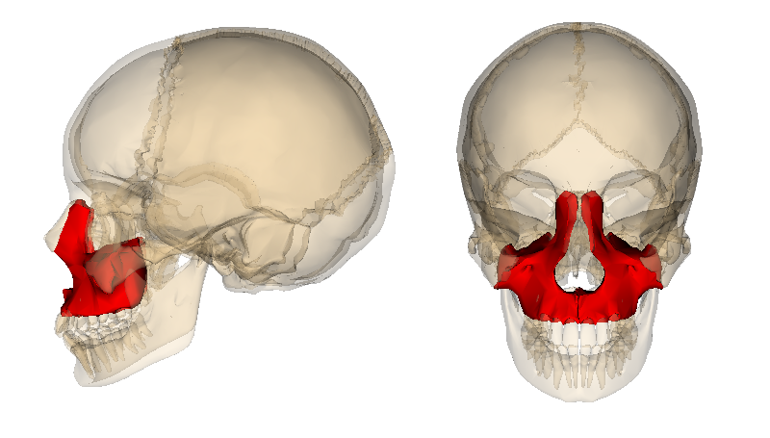
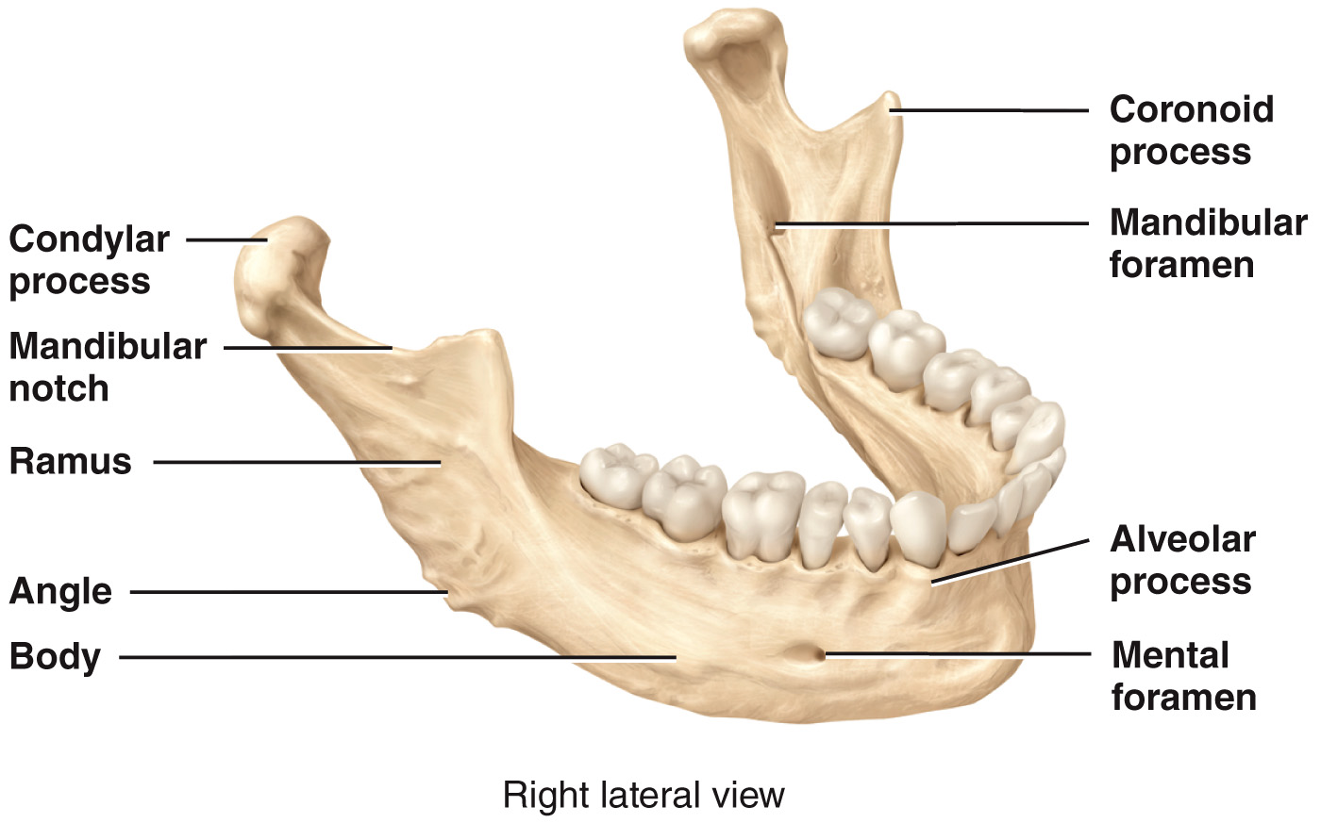
Facial Bones – Closer Looks
maxillae (2): bones of the upper jaw → articulate with every bone of the face except the mandible (lower jaw) → forms part of the orbits, part of the nasal cavity, and most of the hard palate (bony roof of the mouth) → each maxilla contains a large maxillary sinus that empties into the nasal cavity → the alveolar processes of the maxilla are ridge-like arches that contain the alveoli (sockets) for the maxillary (upper) teeth
mandible: largest, strongest facial bone that forms the lower jaw → mental foramen: transmits terminal branches of alveolar nerve and mental vessels → mandibular foramen: transmits mandibular nerve and blood vessels

Slide 19
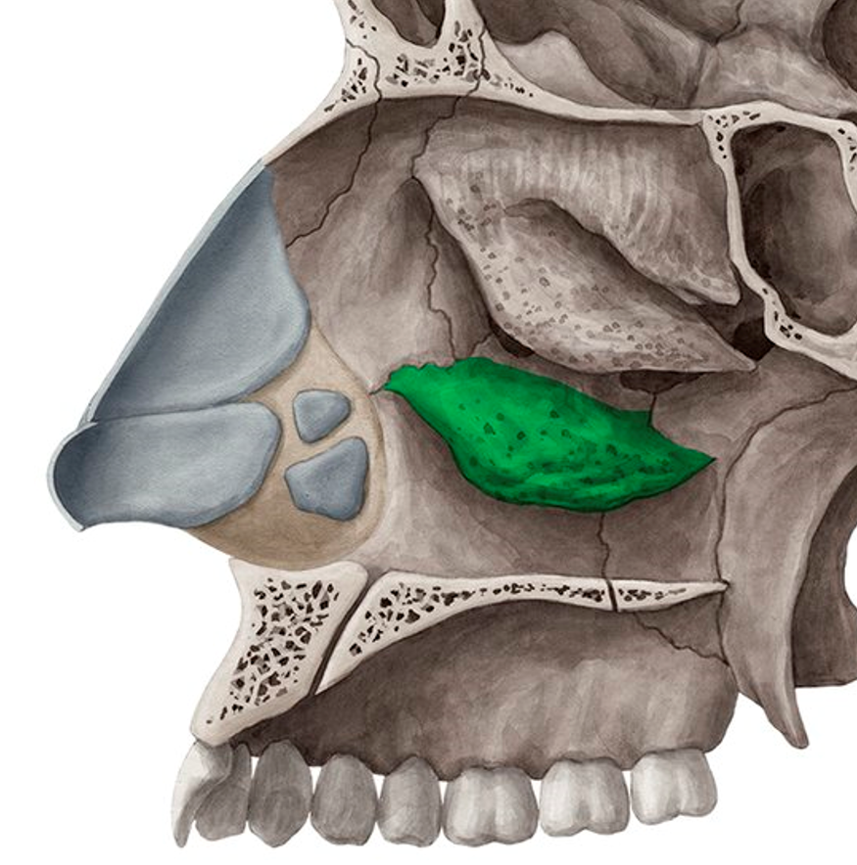
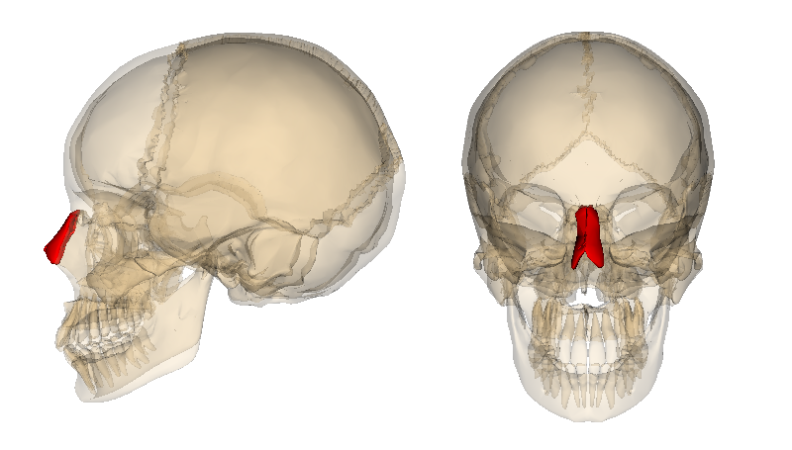
Facial Bones – Closer Looks
inferior nasal conchae (2): form part of (and project into) the nasal cavity → separate bones from nasal conchae of the ethmoid bone → all three pairs of nasal conchae (superior, middle, inferior) increase the surface area of the nasal cavity and help swirl and filter air before it passes into the lungs
nasal bones (2): small, flattened rectangular shaped bones that form the bridge of the nose

Slide 20
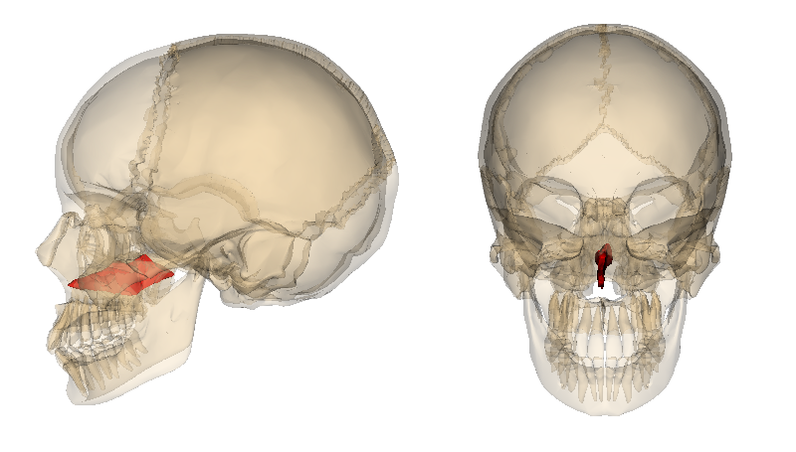
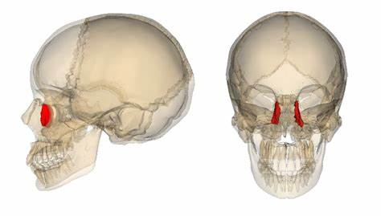
Facial Bones – Closer Looks
vomer: triangular bone that forms the nasal septum (along with the ethmoid) → nasal septum = the partition that divides the nasal cavity into L/R sides
lacrimal bones (2): smallest bones of the face → lacrimal fossa: vertical tunnel formed with the maxilla that houses the lacrimal sac which gathers tears

Slide 21
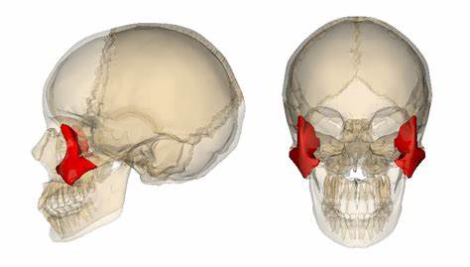
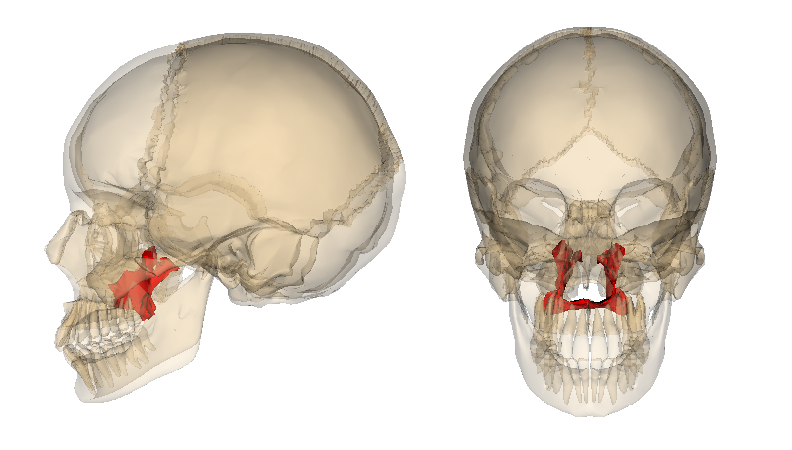
Facial Bones – Closer Looks
zygomatic bones (2): cheekbones, form the prominences of the cheeks and part of the orbit → zygomatic arch: the temporal process of the zygomatic bone projects posteriorly and articulates with the zygomatic process of the temporal bone
palatine bones (2): form the posterior portion of the hard palate, part of the nasal cavity, and a small portion of the orbits

Slide 22
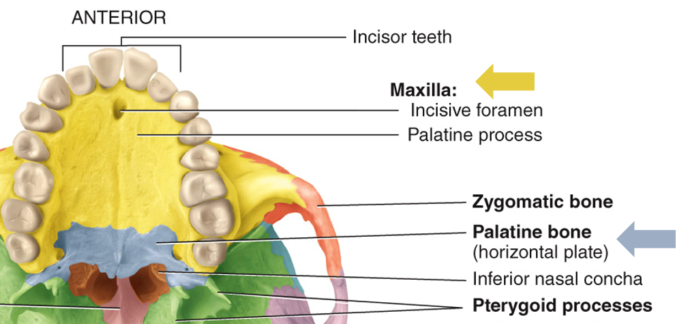
Special Structures – Hard Palate
hard palate: roof of the mouth, formed from maxillae + palatine

Slide 23
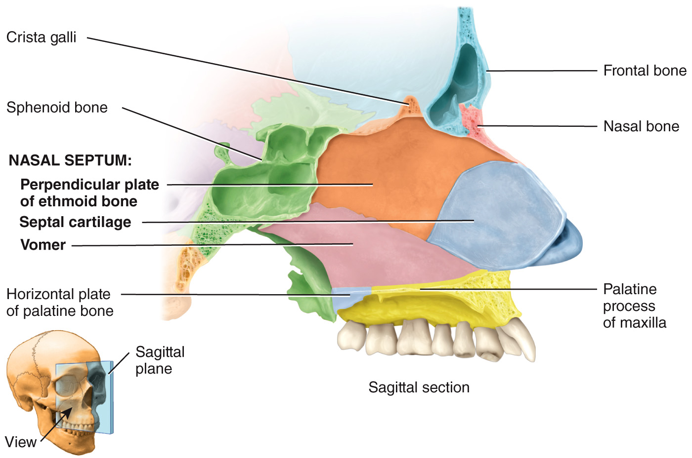
Special Structures – Nasal Septum
nasal septum: separates nose into left and right, composed of vomer, ethmoid bone (perpendicular plate), and septal cartilage

Slide 24
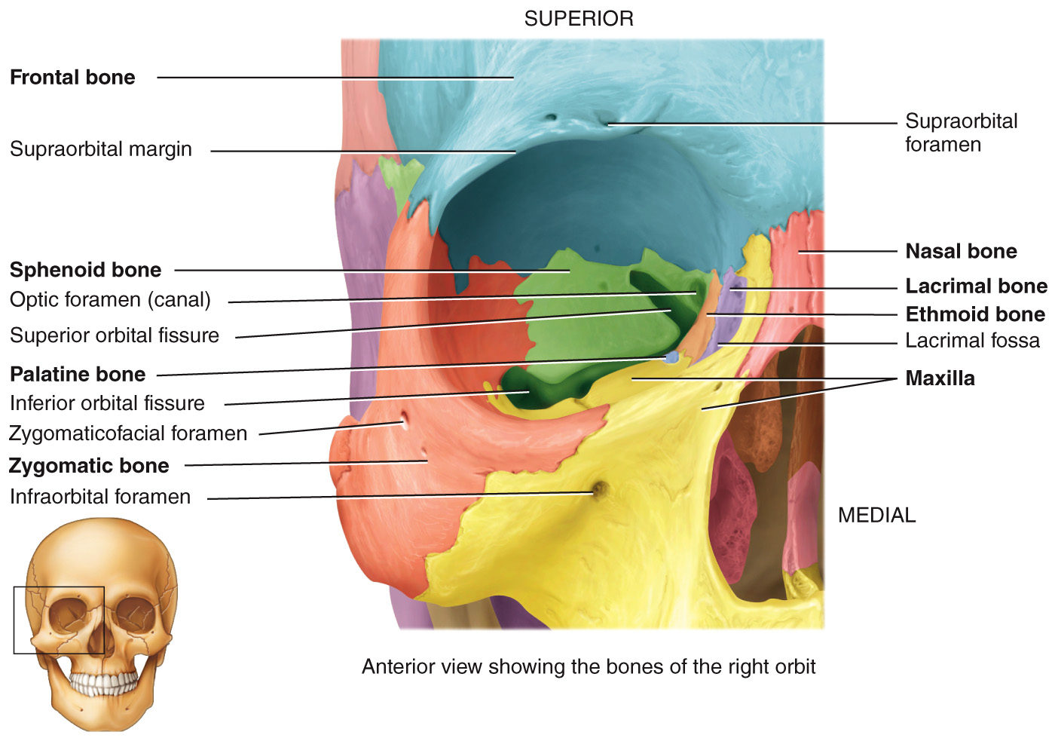
Special Structures – Orbit
orbit: (aka orbital cavity, eye socket) contains the eyeball and associated structures
3 cranial bones = frontal, sphenoid, ethmoid
4 facial bones = palatine, zygomatic, lacrimal, maxilla

Slide 25
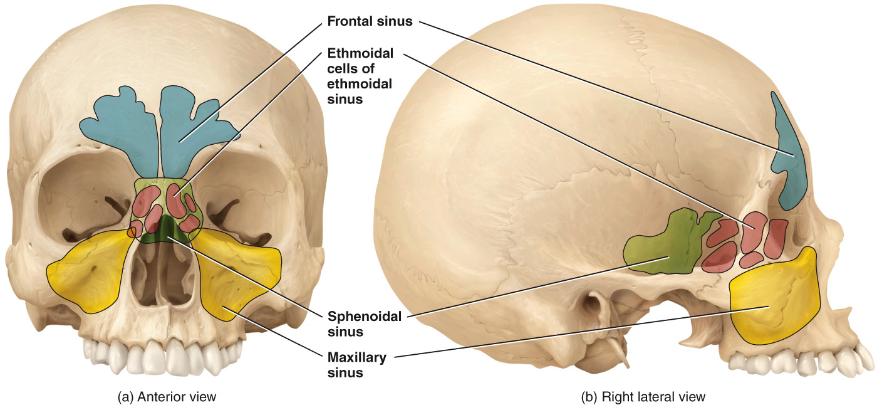
Special Structures – Sinuses
paranasal sinuses: cavities within certain cranial and facial bones near the nasal cavity → lined with mucus membranes that are continuous with the lining of the nasal cavity → sinuses increase the surface area of the nasal mucosa, thus increasing the production of mucus to help moisten and cleanse inhaled air → small or nearly absent at birth, allow the skull to increase in size without a change in the mass of the bone

Slide 26
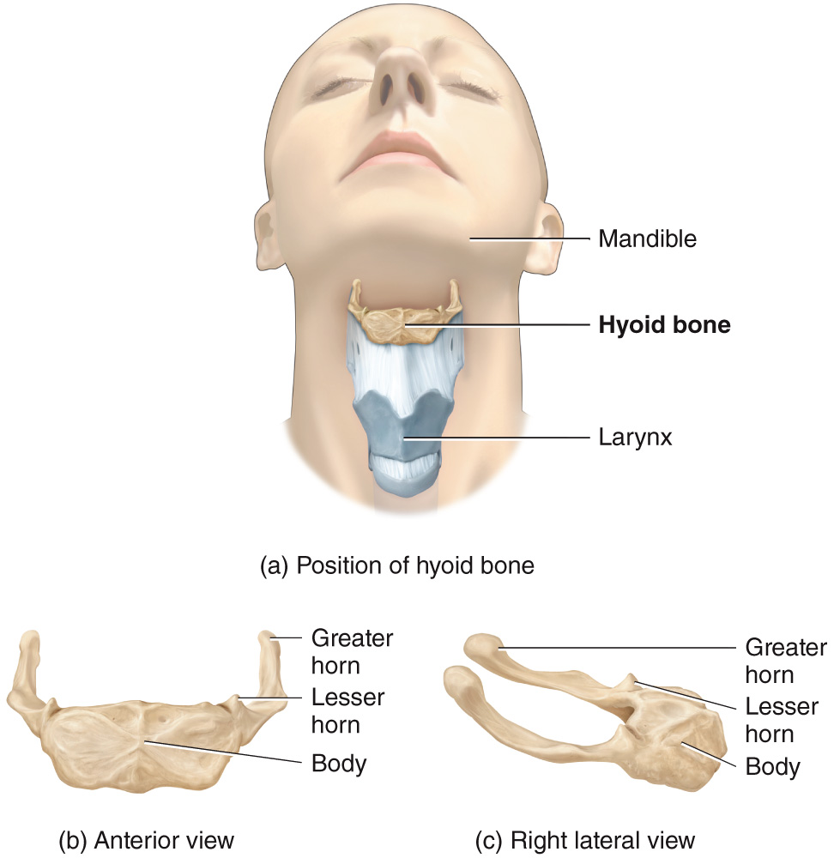
Hyoid Bone
hyoid bone → no articulations with ANY other bone → suspended from the styloid processes of the temporal bones by ligaments and muscles → supports the tongue, providing attachment sites for some tongue muscles and for muscles of the neck and pharynx

Slide 27
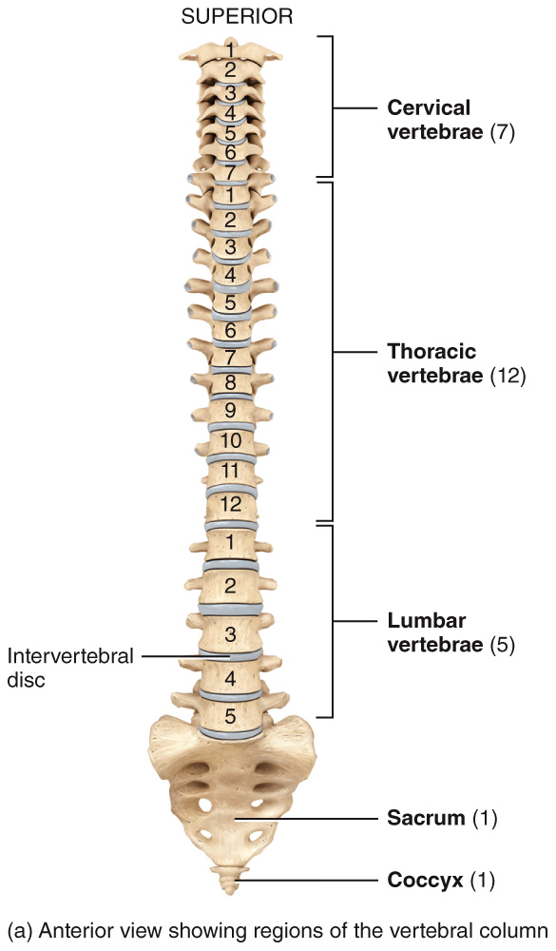
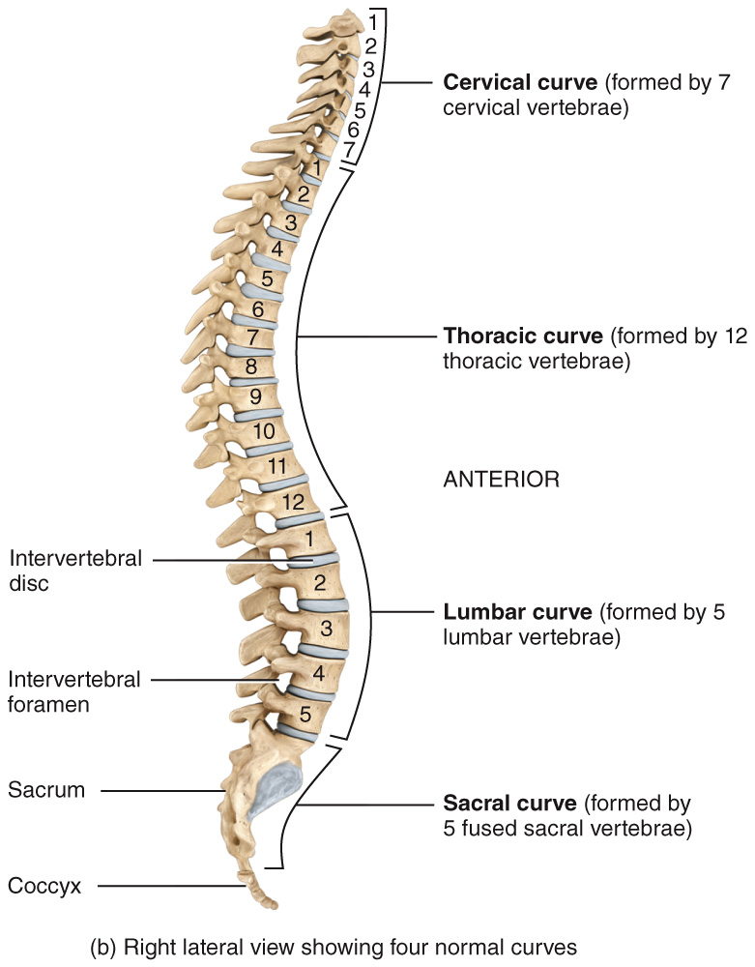
Vertebral Column
vertebral column (aka “spine” “backbone” “spinal column”) → makes up about 2/5 of your total height → contains a series of bones called vertebrae organized into 5 regions [1] cervical [2] thoracic [3] lumbar [4] sacral [5] coccygeal

Slide 28
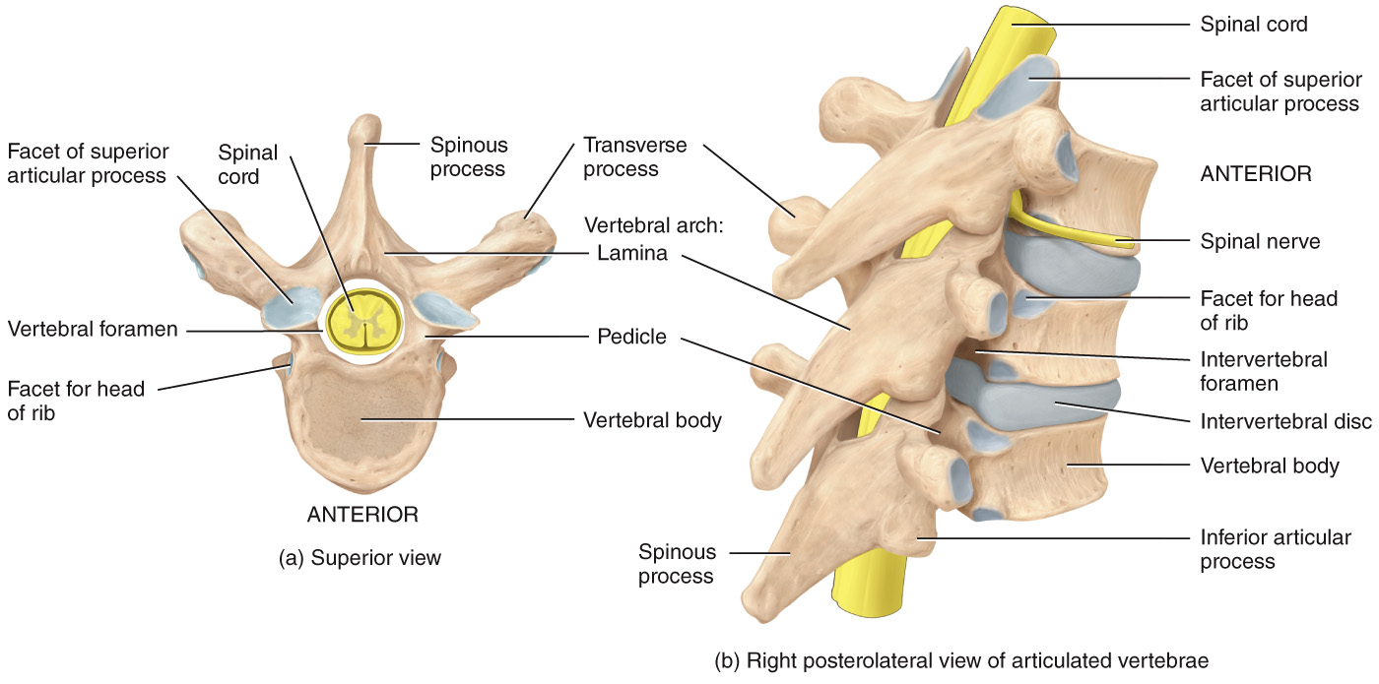
Vertebral Column – Vertebrae
vertebral body: the thick, disc-shaped anterior portion; the weight-bearing part of the vertebra
vertebral foramen: accommodates the spinal cord
processes: 7 processes arise from the vertebral arch [1] transverse process - (2) extends laterally on each side [2] spinous process – projects posteriorly from the junction of the laminae [3] superior articular processes – (2) articulate with the 2 inferior articular processes above them [4] inferior articular processes – (2) articulate with the 2 superior articular processes below them

Slide 29
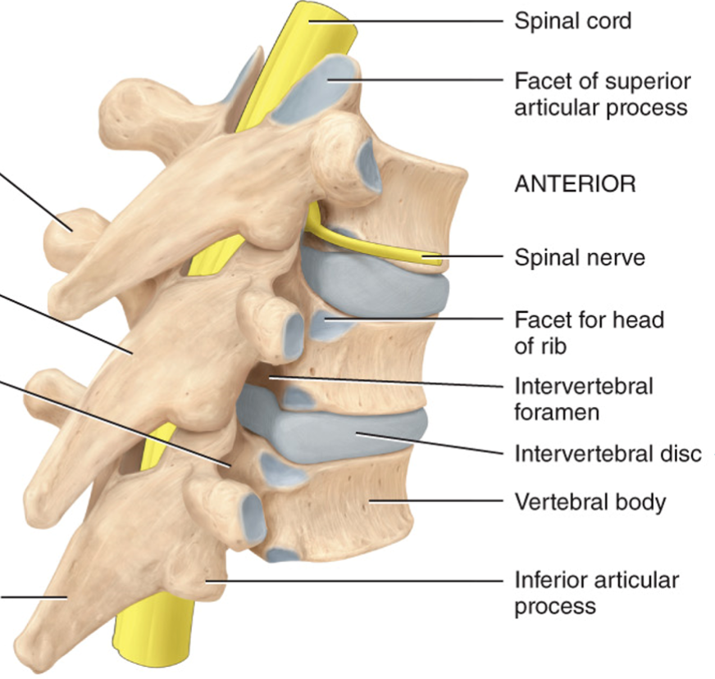
Vertebral Column – Intervertebral Discs
intervertebral discs: fibrocartilage between the bodies of adjacent vertebrae from the 2nd cervical vertebra to the sacrum → fun fact: you are slightly shorter at night because over the course of the day, the discs compress and lose water

Slide 30
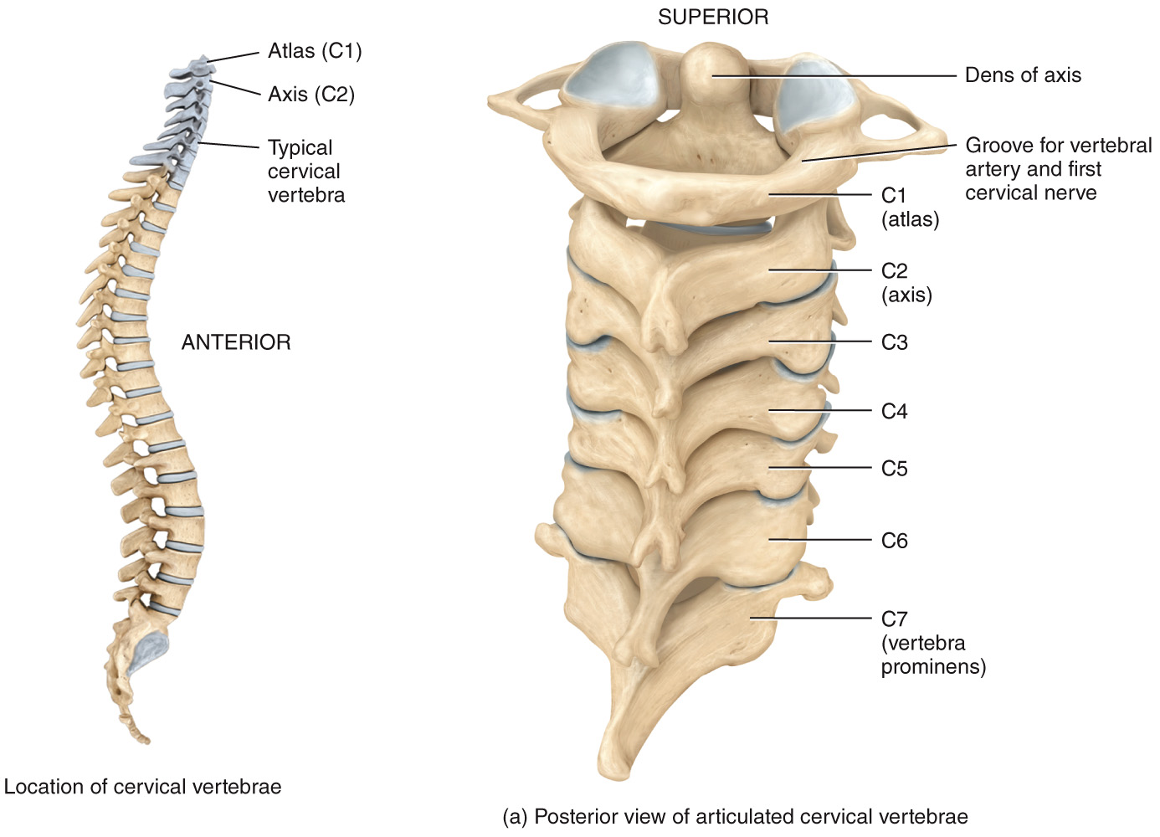
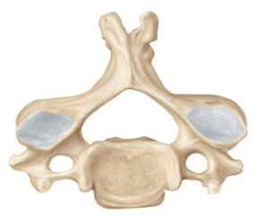
Vertebral Column – Cervical
cervical vertebrae: C1-C7 → smaller than all other vertebrae, except those that form the coccyx → have 3 foramina: 1 vertebral foramen and 2 transverse foramina (vertebral artery and vein) C1 = ATLAS C2 = AXIS

Slide 31
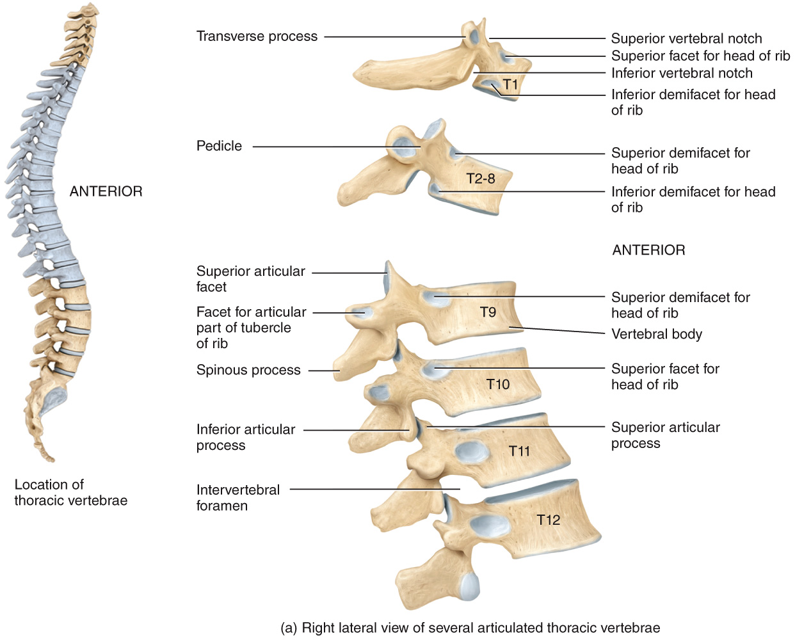
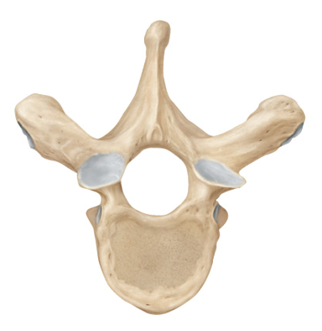
Vertebral Column – Thoracic
thoracic vertebrae: T1-T12 → considerably larger and stronger than cervical vertebrae → articulate with the ribs

Slide 32
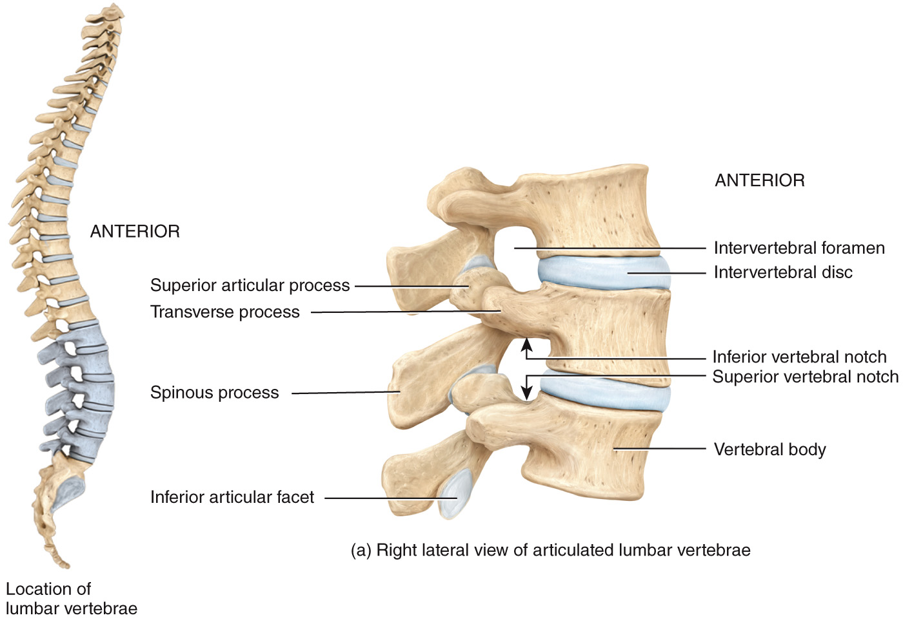
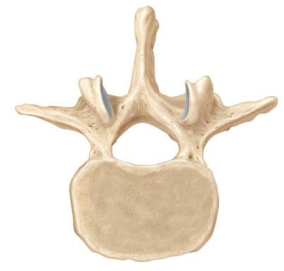
Vertebral Column – Lumbar
lumbar vertebrae: L1-L5 → largest, strongest of the unfused bones in the vertebral column → the spinous processes are well adapted for the attachment of the large back muscles

Slide 33
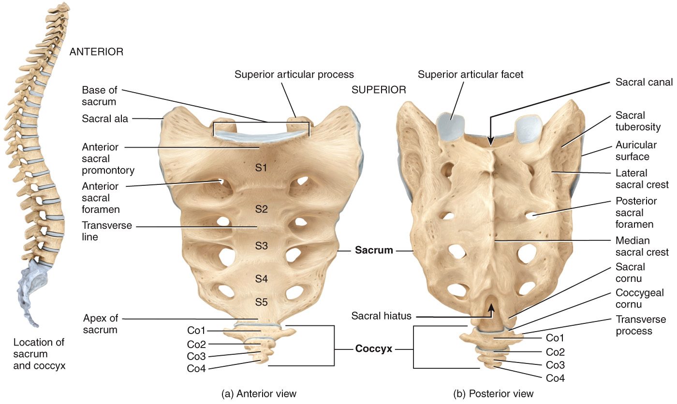
Vertebral Column – Sacrum and Coccyx
sacrum: large triangular bone formed by the fusion of 5 sacral vertebrae (S1-S5) → sacral vertebrae begin to fuse between 16-18 years of age (process completed by 30) → serves as foundation for the pelvic girdle
coccyx (aka “tailbone”): small triangular bone formed by the union of 4 coccygeal vertebrae (Co1-Co4) → fusion occurs between the age of 20-30

Slide 34
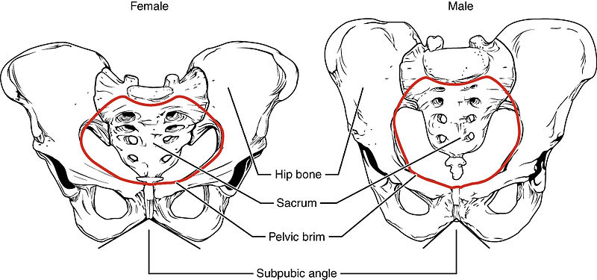


Vertebral Column – Sacrum and Coccyx
the female sacrum is shorter, wider, and more curved between S2-S3

Slide 35
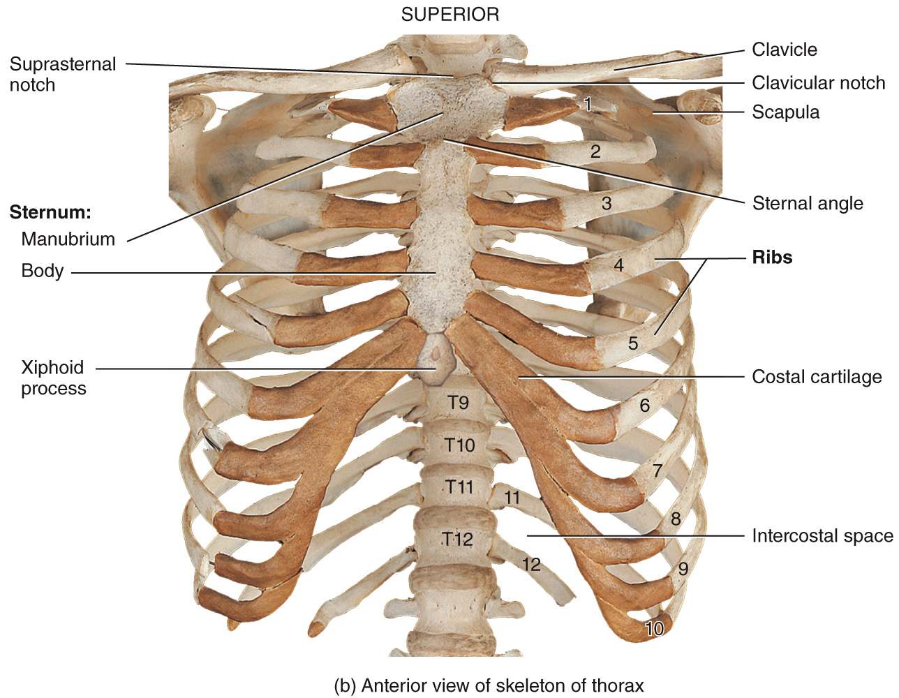
Thoracic Cage
thoracic cage: bony enclosure formed by the [1] sternum, [2] ribs and their [3] costal cartilages, and the bodies of the thoracic vertebrae

Slide 36
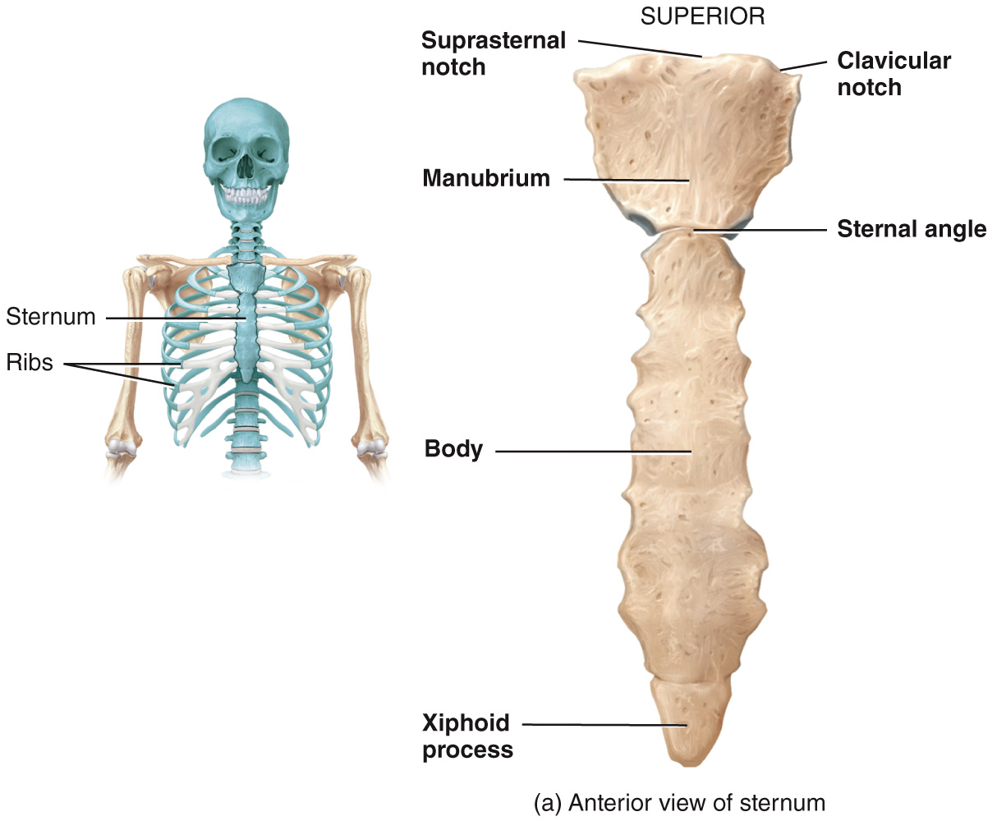
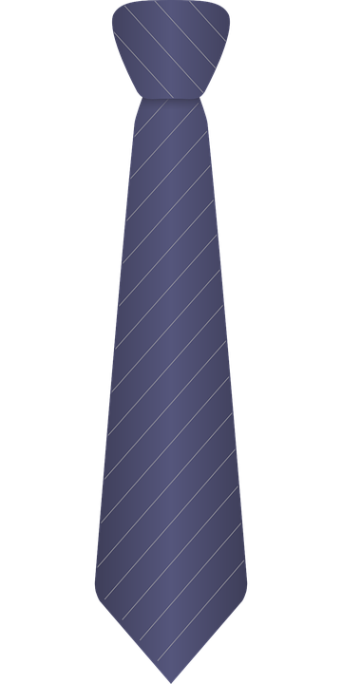
Thoracic Cage – Sternum
sternum (aka breastbone): flat, narrow bone located in the center of the anterior thoracic wall
[1] manubrium: the superior portion
[2] body: the middle and largest part
[3] xiphoid process: inferior and smallest part

Slide 37
Thoracic Cage – Ribs
ribs: 12 pairs, numbered 1-12 from superior to inferior → give structural support to the sides of the thoracic cavity → each rib articulates posteriorly with its corresponding thoracic vertebra
true ribs = those that have costal cartilages that attach directly to the sternum (1-7) false ribs = costal cartilages either attach indirectly to the sternum or do not attach to the sternum at all (8-12)

Slide 38
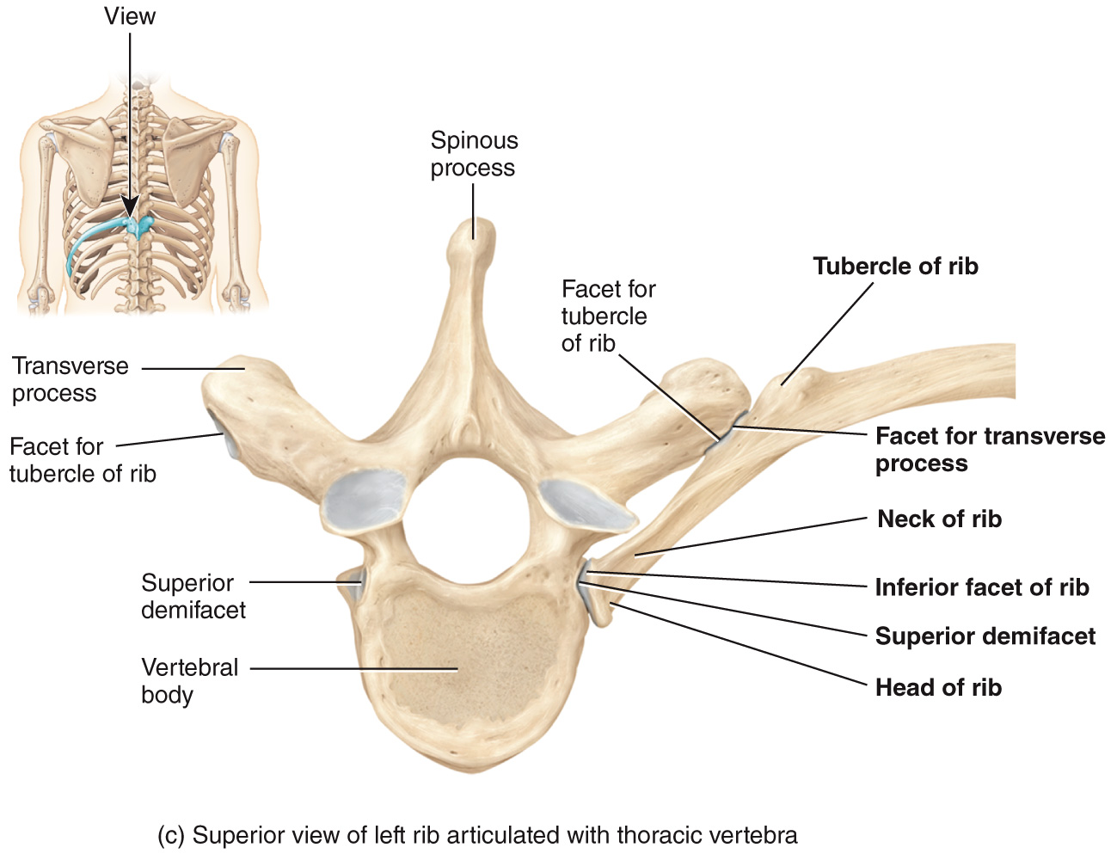
Thoracic Cage – Ribs

Slide 39
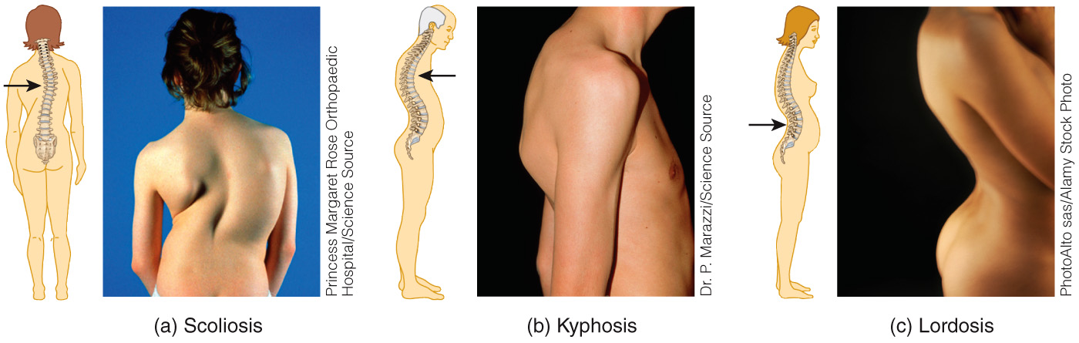
Clinical Connection – Spinal Curvature
scoliosis: increased lateral curvature
kyphosis: increased thoracic curvature, bent forward
lordosis: increased lumbar curvature, bent backwards

Slide 40
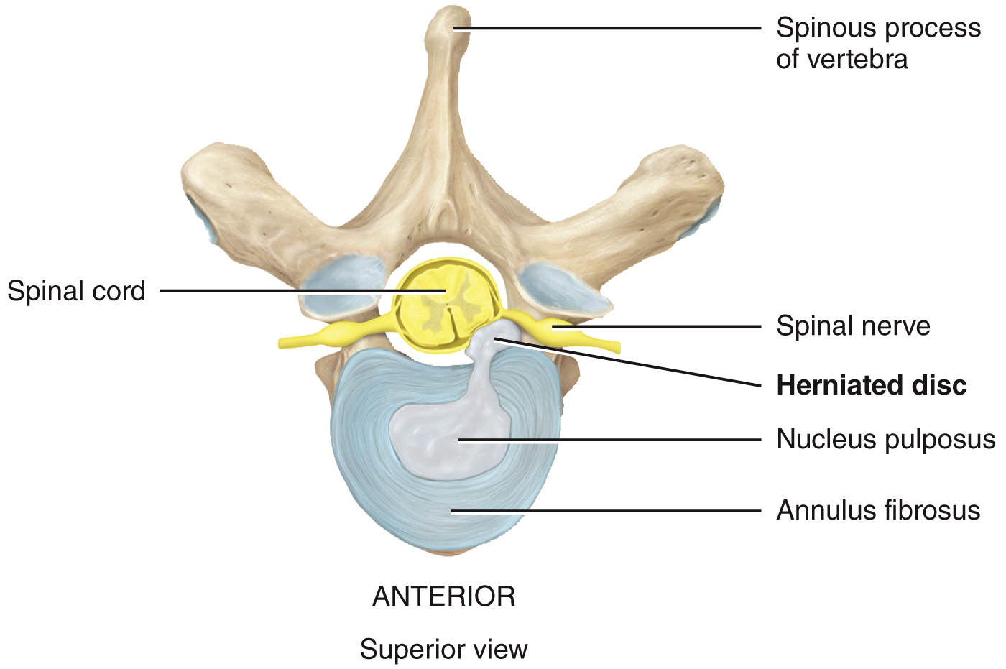
Clinical Connection – Herniated Disc
herniated disc: results from rupture of an intervertebral disc → the soft inner portion of the disc (nucleus pulposus) protrudes outside through the hard outer ring (annulus fibrosus) → causes pain when a nerve is compressed → can be precipitated by strain, injury, and aging

Slide 41


Clinical Connection – Spina bifida
spina bifida: is a congenital neural tube defect in which the spinal column does not form properly and neural tissue protrudes from an opening in the back
→ the degrees of this deformity vary from minor (spina bifida occulta) to severe (spina bifida with meningomyelocele)

Slide 42

Activity/Assignment: Axial Bones
Activity: Skull
Exercise 9: Lab Activity 1
p 108-113
Activity: Orbit of Eye & Bone Surface
Exercise 9: Lab Activity 2-3
p 104-120
Activity: Vertebral Column
Exercise 9: Lab Activity 7-11
p 123-132
ANTERIOR
16
17
18
19
20
Dens
Occipital
condyles
POSTERIOR
(a) Transverse section through skull at the level of the atlas.
Copyright © 2021 John Wiley & Sons, Inc. All rights reserved.

